Slide 1



Is security uniform across Slavic?
Anastasia Makarova, Laura A. Janda & Tore Nesset
Uppsala Universitet & UiT Norges Arktiske Universitet
THREAT-DEFUSER
Notes:
TN: 1-5
AM: 6-10
LAJ: 11-12
AM: 13
TN: 14

Slide 2
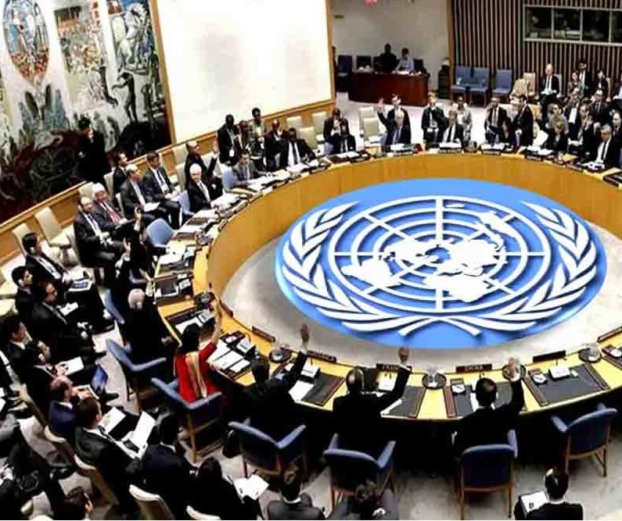
UN Security Council in Slavic languages
Six methods and experiments:
Qualitative analysis of roots
Intercorp: translations of security and safety
Araneum web corpus: sem. vectors
Araneum web corpus: collocations
Chat-GPT
Profiles: constructions and image schemas
Russian | Sovet Bezopasnosti OON
Belarusian | Savet Bjaspeki AAN
Ukrainian | Rada Bezpeki OON
Polish | Rada Bezpieczeństwa ONZ
Czech | Rada bezpečnosti OSN
Slovak | Bezpečnostná rada OSN
Slovene | Varnostni svet ZN
Croatian | Vijeće sigurnosti UN-a
Serbian | Savet bezbednosti UN
Macedonian | Sovetot za bezbednost na ON
Bulgarian | Căvet za sigurnost na OON
Take home message
Methods bring out similarities and differences across Slavic!
Methods should be used with caution!
How is “security” conceptualized in the Slavic languages?

Slide 3
The Security council: Simplified “dialect map”
bez- ... -
Observations:
Five roots:
pas-
pek-
bed-
sigur-
var-
Bez-:
Negative vs. positive construal
Polish
bez-pek-
bez-o-pas-
Czech
Belarusian
Russian
var-
Slovak
Slovene
Ukrainian
Croatian
Serbian
bez-bed-
Bosnian
sigur-
Macedonian
Let’s take a closer look at the various conceptualizations!
Bulgarian

Slide 4
Five roots: Qualitative analysis (1)
Opaque root for modern speakers
váren = ‘safe, secure’
Borrowing from Germanic, cf. German wahren ‘safeguard, observe, take care of’
Transparent: ‘without worry, grief’
Worry, grief = internal psychological state
Cf. Russian bespečnyj ‘careless’
Polish
bez-pek-
bez-o-pas-
Transparent: ‘without danger’
Danger = external threat
Prefix o = ‘around’
Opasnyj: ‘attentive, careful’ → ‘dangerous’
Attestations from 1600s in RNC
Czech
Belarusian
Russian
var-
Slovak
Slovene
Ukrainian
Croatian
Serbian
bez-bed-
Transparent: ‘without misfortune, hardship, sorrow’
Misfortune, hardship, sorrow = external threat or internal psychological state
Bosnian
sigur-
Macedonian
Bulgarian
Opaque for modern speakers
Borrowing, goes back to Latin sēcūrus se ‘free from’ + cura ‘care’

Slide 5
Five roots: Qualitative analysis (2)
Bez- = ‘without’
Transparent
Negative construal
External threat or internal psychological state
bez- ... -
Polish
bez-pek-
bez-o-pas-
Czech
Belarusian
Russian
var-
Slovak
However, this dialect map is simplistic.
Let’s look at a parallel corpus!
Slovene
Ukrainian
Croatian
Serbian
bez-bed-
Bosnian
sigur-
Macedonian
Three pairs of concepts:
Transparent ~ opaque
Negative ~ positive
External threat ~ internal psychological state
Bulgarian
Opaque (not morphologically analyzable)
Positive construal

Slide 6
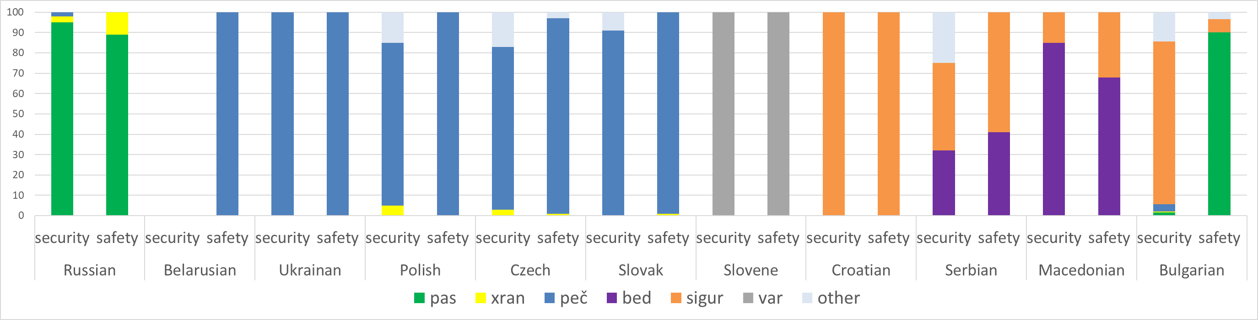
Intercorp: translations of security and safety
Geographic distribution
Confirms analysis from previous slides, but adds nuances
Sixth root: xran related to guarding (“call security” = “call the security guards”)
Other roots are attested in West and South Slavic
Sigur- and bed- compete in Serbian and Macedonian
Security vs. safety
Identical: Ukrainian, Slovene, Croatian
Quantitatively different (same roots, different distribution): Russian, Polish, Czech, Slovak, Serbian, Macedonian
Qualitatively different (different roots): Bulgarian

Slide 7
Semantic vectors
Focus on external, collective threats
Based on Araneum corpus family
Generated lists of 20 most similar words to word for ‘security’ in each language
Numbers = numbers of word on list in relevant category
 | Ru | Uk | Pl | Cz | Sn | Cr | Bu
Cyber, information | 1 | 2 |  | 2 |  | 1 | 3
Fire | 5 | 1 | 2 |  | 1
Nuclear, biology, ecology | 2 | 3 |  |  | 1
Terrorism | 2 |  |  |  |  |  | 2
Energy | 3 | 1 | 1 | 1
Focus on indivdual, internal states
Collective
External
 | Ru | Uk | Pl | Cz | Sn | Cr | Bu
Comfort |  |  | 1 |  | 2 | 1
Stability |  |  | 1 | 1 | 1 | 1 | 1
Integrity, confidence | 1 |  | 1 | 1
Efficiency |  |  | 1 | 1 | 1 | 1
Health |  | 1 | 1 | 1 |  | 2
Privacy | 1 | 2 |  |  |  | 1 | 1
Individual
Internal
Semantic vectors: Ukrainian groups with Russian.
Lexical roots: Ukrainian groups with Polish.

Slide 8
Semantic vectors: GNU-plots
Polish
RUSSIAN
Psych.
states
Civil threats
Psych.
states
Military threats
Guards
Civil threats
Military threats
The same groups of concepts recur in both languages, but with different “centers of gravity”.
Notes:
NB! Polsk – tre- og fempunkts handler om sikkerhetsbelter av ulike typer – sikekrhetsutstyr for fjellklatrere, vinduspussere, trafikksikkerhet.
Forkortelsene FRSC Federal road safety corps, NHTSA National Highway Traffic Safety Administration

Slide 9
Collocations: nominal words
Confirms picture from semantic vectors: similar semantic fields
Russian and Ukrainian very similar
Collocations
Words that occur together more frequently than one should expect based on the frequency of each word
Araneum corpora
Provide ranked lists of collocations for five languages:
Semantic fields | Ru | Uk | Pl | Cz | Bu
Fire | požarnyj | požežnyj |  | požární
Cyber, information | informacionnyj | informacijnyj |  | kybernetický | informacionen
Nuclear, biology, ecology | ėkologičeskij | ekologičnyj, jadernyj |  | jaderný
Energy |  | energetičnyj | energetyczny |  | energien
Traffic | dorožnyj, remen’, dviženie, poduška | dorožnij, rux | drogowy, ruch, pas | silniční, provoz
Providers, organizations, procedures | trebovanie, texnika, služba, sistema, mera, pravilo, sobljudenie | texnika, pravilo, služba, dotrymannja | służba, system |  | služba, sistema
Food |  | prodovol’čyj |  | potravina

Slide 10
Collocations: verbs and verbal nouns
What can you do with security?
Provide, ensure, maintain:
Ru: obespečit’ ‘provide, ensure’
Pl: zapewnić ‘ensure’, dbać ‘provide, ensure’
Cz: zajistit/zajišťovat ‘provide, ensure’
Guarantee:
Pl: gwarantować ‘guarantee’,
Bu: garantiram ‘guarantee’
Increase:
Pl: zwiększyć ‘increase’
Cz: zvýšit/zvyšovat ‘increase’
Improve:
Pl: poprawa ‘improvement’
Observe, obey, abide:
Ru: sobljudenie ‘observance, abidance’
Metaphorical conceptualizations:
Security = commodity that can be given to you
Security = someone can promise to do whatever is needed for you to have that commodity.
Security = a scalar property that can be higher or lower on a quantitative scale
Security = a scalar property that can be higher or lower on a qualitative scale
Security = a set of rules you must obey
Security is a transferable commodity, a scalar property, and a set of rules.

Slide 11
Chat-GPT
What are the associations in various languages?
Example: Slovene
We asked the bot the following questions:
You have access to a large amount of language data in Slovene. I would like to ask you to take a look at that data, and in particular please look at how the word varnost is used in the language data in Slovene that you have access to. Based on your data, please answer for me the following questions about how the word varnost is used in Slovene:
1) What kinds of semantic associations are there with the word varnost in Slovene?
2) What kinds of collocations do you find with the word varnost in Slovene?
3) When people use the word varnost in Slovene, what kinds of things are they thinking about?
4) What kinds of domains (politics, society, health, economics, etc.) are relevant when people use the word varnost in Slovene?
Please write in Slovene when answering these questions. Thank you.
Answers from the bot (for Slovene):
S besedo varnost v slovenščini so povezane različne semantične konotacije, kot so zaščita pred nevarnostjo, ohranjanje reda in miru, zanesljivost, zaupanje, stabilnost, varovanje človekovih pravic in svoboščin, fizična in finančna varnost ter varnost na delovnem mestu.
V slovenščini se beseda varnost pogosto pojavlja v različnih kolokacijah, kot so nacionalna varnost, varnostni sistem, varnostna politika, varnostna služba, varnostni ukrepi, varnostni pas, varnostni list, varnostna oprema, varnostni standardi itd.
Ko ljudje v slovenščini uporabljajo besedo varnost, lahko razmišljajo o različnih stvareh, kot so osebna varnost, varnost v družbi in skupnosti, varnost pri delu, finančna varnost, varnost v prometu, varnost v primeru naravnih nesreč, nacionalna varnost in varnost države itd.
Beseda varnost se nanaša na različna področja in domene, kot so politika, družba, zdravje, delo, finance, transport, energetika, okolje in naravne nesreče, kibernetska varnost, obramba in vojska ter mednarodna varnost in stabilnost.
Then we classified the results and summarized the findings in a table!

Slide 12
Chat GPT summarized
Ukrainian and Slovene have associations to more semantic fields
(“intermediate” positions in Slavic)
Ukrainian and Slovene have associations to more semantic fields
Bulgarian sigurnost and bezopasnost have very similar associations!
Politics, society and health are attested in all the languages.
 | Ru | Uk | Pl | Cz | Sk | Sn | Cr | Srb | Mac | Bu s | Bu b
politics and society | + | + | + | + | + | + | + | + | + | + | + | 11
health | + | + | + | + | + | + | + | + | + | + | + | 11
IT and technology | + | + | + | + | + | + | + | + |  | + | + | 10
transportation | + | + | + | + | + | + |  | + | + | + | + | 10
state | + | + | + |  | + | + | + | + | + |  | + | 9
person and property | + | + |  |  | + | + | + | + | + | + | + | 9
economy and industry | + | + | + |  | + | + | + |  | + |  | + | 8
workplace | + |  | + | + | + | + |  | + |  | + | + | 8
energy |  | + | + |  | + | + | + |  |  | + |  | 6
crime |  |  |  | + | + |  |  | + | + | + | + | 6
military |  | + | + |  | + | + |  |  |  |  |  | 4
environment | + |  | + |  |  | + |  |  |  |  |  | 4
accidents and natural disasters |  | + |  | + |  | + |  |  |  |  |  | 3
terrorism |  | + |  |  |  |  |  | + |  |  |  | 2
global, international |  | + |  |  |  | + |  |  |  |  |  | 2
education and science |  | + | + |  |  |  |  |  |  |  |  | 2
Total | 9 | 13 | 11 | 7 | 11 | 13 | 7 | 9 | 7 | 8 | 9
South Slavic languages have associations to fewer semantic fields.
Notes:
Observations:
1: A hierarchy of topics/fields – some are better attested across Slavic than others. From top to bottom in the table.
2: Some languages have more associations to more fields - a more even distribution across fields.
3: A north/south divide? the lower right corner has fewer pluses in the table, so these fields appear to be less well represented in South Slavic (except Slovene)
4: Bulgarian: surprising that the two words have very similar distributions!

Slide 13
Constructional profiles: three conceptualizations
Based on RNC (parallell subcorpus) + native speakers and google
In + safety
Russian: v bezopasnosti
Belarusian: u bjaspeci
Ukrainian: u bezpeci
Czech: v bezpečí
Slovak: v bezpečí
Bulgarian: v bezopasnost (also outside danger: izvăn opasnost)
On + safe
Serbian, Croatian: na sigurnom
Slovene: na varnem
To be safe
Polish: jest bezpieczny
Croatian: e bezbeden
Bulgarian: e siguren
Safety = container that you can be inside (or outside).
Safe = a plane you can be on top of.
Safe = property you can have, something you can be
Security/safety can be conceptualized through various image schemas.

Slide 14

Let’s wrap up!
Security in Slavic
Relevant concepts:
Transparent ~ opaque
Negative ~ positive
External threat ~ internal psychological state
Collective ~ individual
Semantic fields – vectors, collocations, chat GPT:
A small set of fields recur across languages
There are differences among the Slavic languages
Metaphorical conceptualizations
Transferable commodity
Scalar property
Set of rules
Constructional profiles and image schemas
Container
Plane
Property
Methodology
Six methodological “experiments” involving available digital tools:
Qualitative analysis of roots
Intercorp: translations of security and safety
Araneum web corpus: Semantic vectors
Araneum web corpus: Collocations
Chat-GPT
Profiles: image schemas
Methodology
The relevant tools give some conclusions,
... but should be used with caution – especially Chat-GPT!
Combination of methods is valuable!

